Slide 1
5. Association Rule Mining

Slide 2







Example: Shopping Basket Analysis
Wal-Mart
On Fri afternoon 60% of people who buy diapers also buy beer
Move beer close to diapers to sell more beers!
Purchase
transactions
Notes:
The classical example of a data mining problem is "market basket analysis". Retail stores gather information on what items are purchased by their customers. The expectation is, by finding out what products are frequently purchased together (i.e., are associated with each other), identifying ways to optimize the sales of the products by better targeting certain groups of customers (e.g., by planning the layout of a store or planning advertisements). A well-known example was the discovery that people who buy diapers also frequently buy beers (probably exhausted fathers of small children). Therefore nowadays one finds frequently beer close to diapers in supermarkets, and of course also chips close to beer. Similarly, amazon exploits this type of associations in order to propose to their customers books that are likely to match their interests. This type of problem was the starting point for one of the best known data mining techniques: association rule mining.

Slide 3
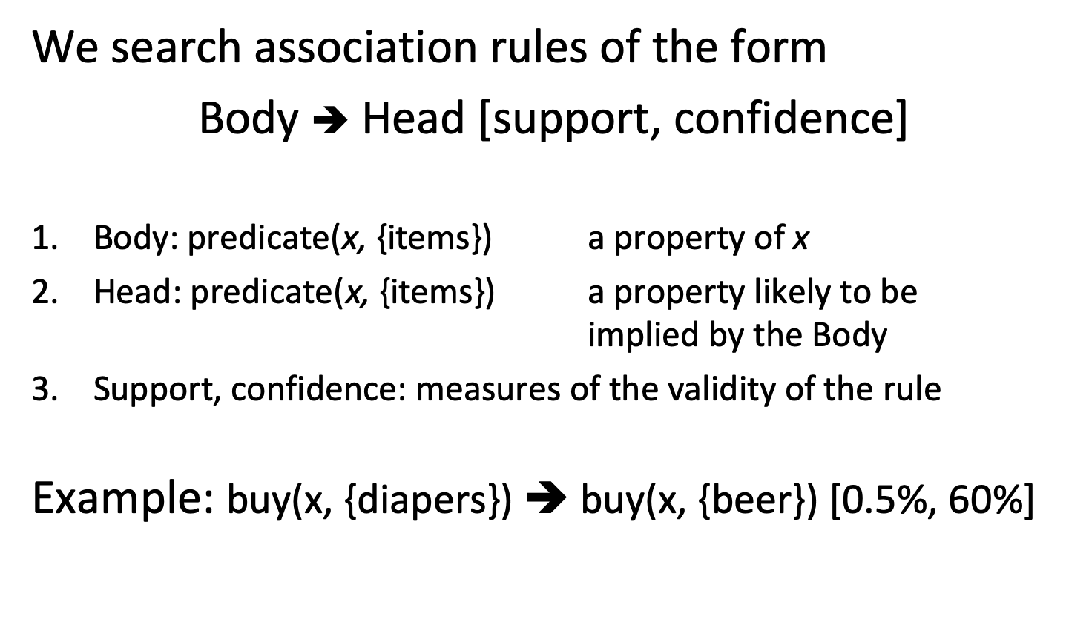
Association Rules
We search association rules of the form
Body ➔ Head [support, confidence]
Body: predicate(x, {items}) a property of x
Head: predicate(x, {items}) a property likely to be implied by the Body
Support, confidence: measures of the validity of the rule
Example: buy(x, {diapers}) ➔ buy(x, {beer}) [0.5%, 60%]
Notes:
Association rule mining is a technique for discovering unsuspected data dependencies and is one of the best known data mining techniques. The basic idea is to identify from a given database, consisting of item sets (e.g., shopping baskets), whether the occurrence of specific items, implies also the occurrence of other items with a high probability. In principle, the answer to this question could be easily found by an exhaustive exploration of all possible dependencies, which is however prohibitively expensive. Association rule mining thus solves the problem of how to search efficiently for those dependencies.

Slide 4
Single- and Multi-dimensional Rules
Single-dimensional rules
buy(x, {diapers}) ➔ buy(x, {beer}) [0.5%, 60%]
Multi-dimensional rules
age(x, {19-25}) ∧ buy(x, {chips}) ➔ buy(x, {coke}) [10%, 75%]
Notes:
As shown in the previous example, we can have two kinds of association rules. Those that associate data for a single predicate (such as buys), which are called singe-dimensional rules, and those that use several different predicates (such as buys and age), which are called multi-dimensional rules.

Slide 5
From Multi- to Single-dimensional Rules
Use predicate/value pairs as items
age(x, {19-25}) ∧ buy(x, {chips}) ➔ buy(x, {coke})
customer(x, {age=19-25}) ∧ customer(x, {buy=chips}) ➔ customer(x, {buy=coke})
Simplified notation of single-dimensional rules
{diapers} ➔ {coke}
{age=19-25, buy=chips} ➔ {buy=coke}
Notes:
However, it is straightforward to transform multi-dimensional association rules into single-dimensional rules, by considering different predicates applied to the same items as different items. Therefore in the following we will only consider single-dimensional association rules. As a result we will also use a simplified notation for the rules, where instead of using predicates we just distinguish different items.

Slide 6
2. Scoring Function
Customer
buys both
Support: probability that body and head occur in transaction p({body, head})
Confidence: probability that if body occurs, also head occurs p({head} | {body})
Customer
buys diaper
Customer
buys beer
Notes:
This example illustrates the basic concepts used in association rule mining. Transactions consist of a transaction identifier and an itemset. The itemset is the set of items that occur jointly in a transaction (e.g., the items bought). Now we can define the measures used to evaluate the quality of a rule.
Support is the number of transactions in which the association rule holds, i.e., in which all items of the rule occur (e.g., both beer and diaper). If this number is too small, probably the rule is not relevant. Confidence is the probability that in case the body of the rule (the condition) is satisfied also the head of the rule (the conclusion) is satisfied. This indicates to which degree the rule is satisfied, in those cases where it is applicable.

Slide 7
Support and Confidence
Rule1: {beer} ➔ {diaper} Rule2: {diaper} ➔ {beer}
p({beer, diaper})=2/4 p({diaper, beer})=2/4
p({diaper} | {beer})=2/3 p({beer} | {diaper})=2/2
{beer} ➔ {diaper}[50%, 66%] {diaper} ➔ {beer}[50%, 100%]
Notes:
Here we compute support and confidence for two different rules.

Slide 8
Support and Confidence
Let’s assume p({A, B}) is above threshold (high support)
conf(A ➔ B): high conf(A ➔ B): low
conf(B ➔ A): low conf(B ➔ A): low
conf(A ➔ B): low conf(A ➔ B): high
conf(B ➔ A): high conf(B ➔ A): high
B
A
B
A
A
A
B
B
Notes:
Here we illustrate the meaning and importance of the "direction" of an association rule. We assume that in all cases the intersection areas (i.e., the support) are above the required threshold. Then four combinations for the confidence are possible. Thus association rules not only express a high probability of co-occurrence of items, such as in the last case, where confidence is high in both directions, but also conditional dependencies among the occurrences of items (or inclusion relationships).

Slide 9
Definition of Association Rules
Terminology and Notation
Set of all items I, subset of I is called itemset
Transaction (tid, T), T ⊆ I itemset, transaction identifier tid
Set of all transactions D (database), Transaction T ∈ D
Association Rules A ➔ B [s, c]
A, B itemsets (A, B ⊆ I)
A ∩ B empty
s(A ➔ B ) = s(A ∪ B) = p(A ∪ B) = count(A ∪ B) / |D| (support)
c(A ➔ B) = p(B | A) = s(A ∪ B) / s(A) (confidence)
Notes:
Here we summarize the basic concepts that constitute the structure of the associatino rule patterns and the measures for their evaluation that are used in association rule mining.
The support is computed as the number of occurrences of A and B together in a transaction, divided by the total number of transactions. This corresponds to the probability that a transaction contains A $∪$ B.
The confidence is computed as the support of A U B divided by the support of A, that is, the frequency of the elements in the union of A and B in a transaction divided by the frequency of A. This corresponds to the conditional probability that a transaction having A also contains B

Slide 10
10 itemsets out of 100 contain item A, of which 5 also contain B. The rule A ➔ B has:
5% support and 10% confidence
10% support and 50% confidence
5% support and 50% confidence
10% support and 10% confidence

Slide 11
10 itemsets out of 100 contain item A, of which 5 also contain B. The rule B ➔ A has:
unknown support and 50% confidence
unknown support and unknown confidence
5% support and 50% confidence
5% support and unknown confidence

Slide 12
Association Rule Mining: Problem
Problem
Given a database D of transactions (tid, T)
Find
all rules A ➔ B [s, c]
such that s > s_{min} (high support)
and c > c_{min} (high confidence)
Notes:
The problem of mining association rules is now defined as follows:
Given a database of transactions, find all rules that correlate the presence of one set of items with that of another set of items where the support and the confidence are above a given threshold. In other words, find all rules that have high support and confidence.

Slide 13
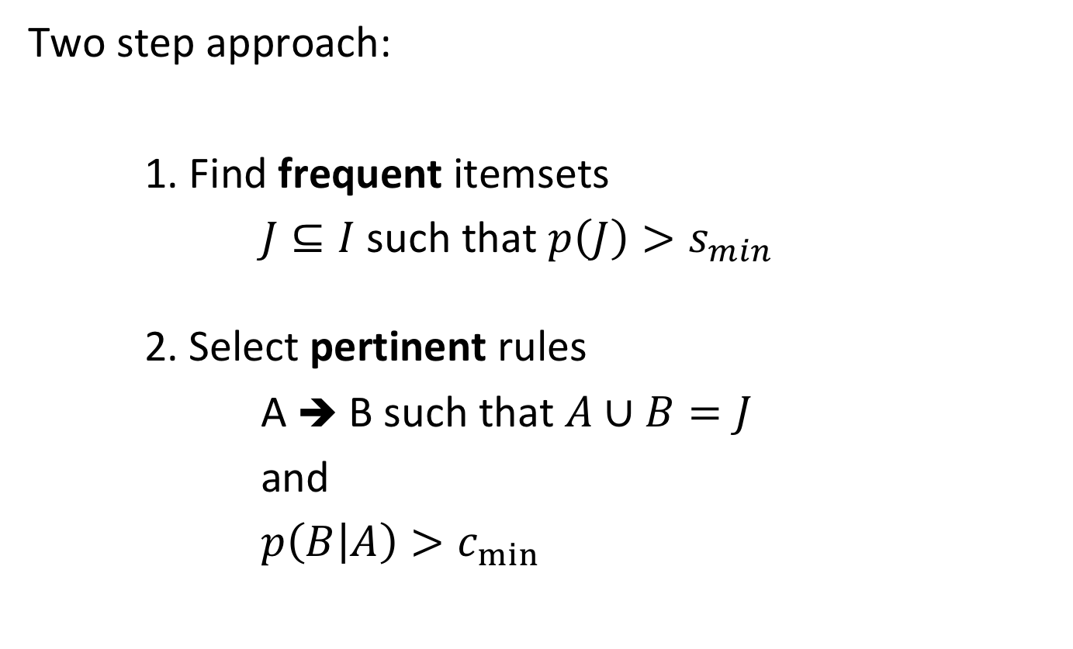
Association Rule Mining Approach
Two step approach:
1. Find frequent itemsets
$J⊆I$ such that $p\left(J\right)>s_{min}$
2. Select pertinent rules
A ➔ B such that $A∪B=J$
and
$p\left(B | A\right)>c_{min}$
Notes:
We will approach the problem in two steps, by first considering only the problem of finding itemsets that satisfy the condition on having a high support, which is a necessary condition for a rule to be an association rule, and then extracting from those itemsets the rules that have a high confidence.

Slide 14
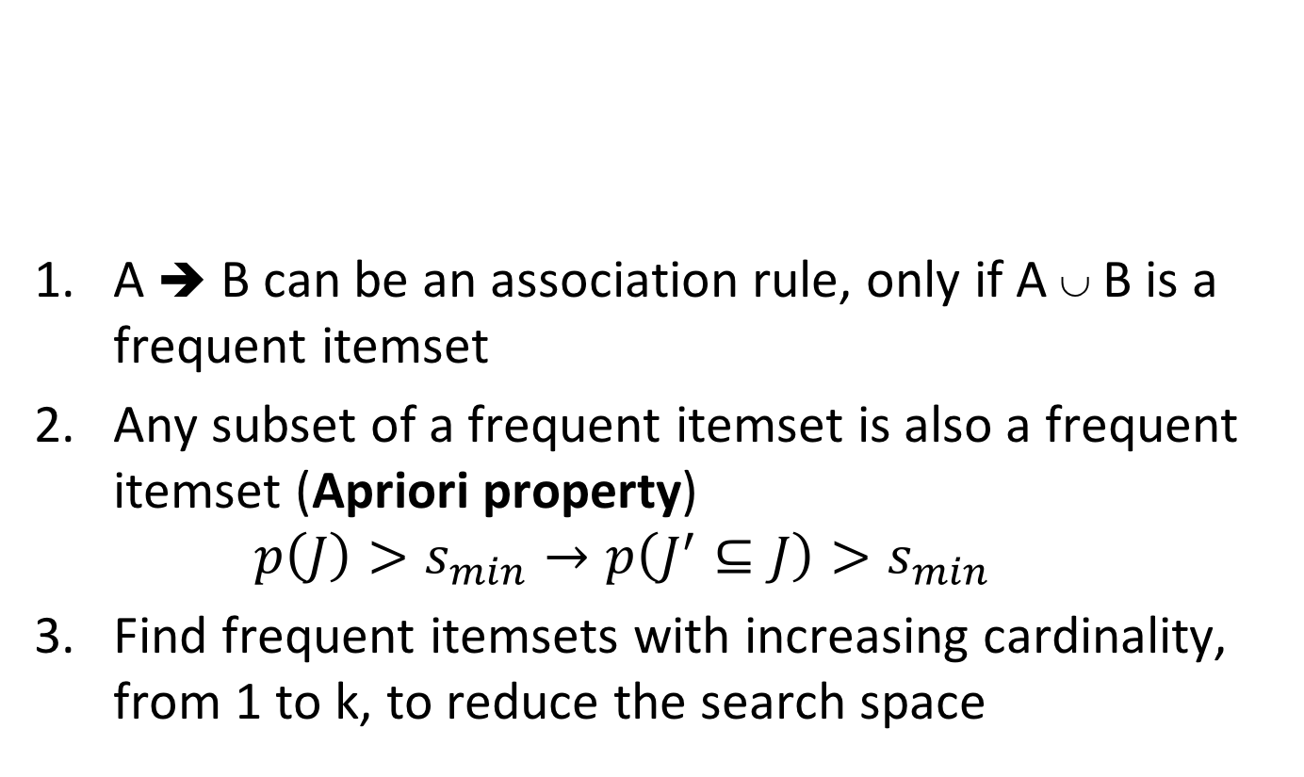
Frequent Itemsets
Frequent Itemset | Support
{beer} | 0.75
{milk} | 0.75
{diaper} | 0.5
{beer,milk} | 0.5
{beer, diaper} | 0.5
{milk, diaper} | 0.25
A ➔ B can be an association rule, only if A ∪ B is a frequent itemset
Any subset of a frequent itemset is also a frequent itemset (Apriori property) $p\left(J\right)>s_{min}→p\left(J^{′}⊆J\right)>s_{min}$
Find frequent itemsets with increasing cardinality, from 1 to k, to reduce the search space
Notes:
A necessary condition for finding an association rule of the form A->B is that it has a sufficiently high support. Therefore, for finding such rules, we can first try to find itemsets within the transactions that occur sufficiently frequent. These are called frequent itemsets. Second we can observe that any subset of a frequent itemset is necessarily also a frequent itemset. This is called the apriori property. The a priori property is a central idea in the algorithm we will introduce that will be used for multiple purposes. A first use of this property is the observation that we can search for frequent itemsets by searching them by increasing cardinality: once frequent itemsets of lower cardinality are found, only itemsets of larger cardinality need to be considered that contain one of the frequent itemsets already found. This allows us to dramatically reduce the search space.

Slide 15
Exploiting the Apriori Property
If we know the frequent (k-1)-itemsets, which is a candidate frequent k-itemset X?
Any (k-1)-itemset that is subset of X must be frequent
Any ordered (k-1)-itemset that is subset of X must be frequent
In particular, two ordered (k-1)-itemsets that are subsets of X and differ only in their last position must be frequent
Notes:
Assume that we know frequent itemsets of size k-1 and want to construct a itemset of size k (a k-itemset). What properties does such a k-itemset has to satisfy?
We can definitely say, that any subset of size k-1 must be frequent. We can also order those subsets by their elements. We can that even say that two order subsets that differ only in the last position must be frequent. This gives is now a possiblity to construct k-itemsets systematically.

Slide 16
Exploiting the Apriori Property: Candidates
A
B
C
D
Frequent k-itemset
A
B
C
A
B
D
Frequent (k-1)-itemset
Frequent (k-1)-itemset
The union of two (k-1)-itemsets that differs only by one item is a candidate frequent k-itemset
Notes:
By inverting the argument, we can see this also as a way to construct frequent k-itemsets. We take two (k-1) item sets which differ only by one item and take their union. This step is called the join step and is used to construct POTENTIAL frequent k-itemsets (called candidate k-itemset)

Slide 17
Example
Frequent Itemset | Support
{beer} | 0.75
{milk} | 0.75
{diaper} | 0.5
{beer,milk} | 0.5
{beer, diaper} | 0.5
{milk, diaper} | 0.25
{beer} and {milk} differ by one item, thus {beer,milk} is a candidate 2-itemset
{beer, milk} and {beer, diaper} differ by one item, thus {beer, diaper, milk} is a candidate 3-itemset
Notes:
Note that the candidate itemsets generated by the join step are not necessarily frequent itemsets, as the example illustrates. The condition we use is necessary, but not sufficient.

Slide 18
Exploiting the Apriori Property: JOIN step
Given the frequent (k-1)-itemsets, L_{k-1}, we can construct a candidate set C_{k} by joining two (k-1)-itemsets that differ by exactly 1 item in the last position
Algorithm (JOIN)
Sort the itemsets in L_{k-1}
Find all pairs with the same first k-2 items, but different k-1th item
Join the two itemsets in all pairs and add to C_{k}
Notes:
The construction of potential k-itemsets, so-called candidates, from (k-1)-itemsets, can be organized in a way that minimizes the number of candidates being generated. By sorting the items only items that are the highest in the order are the ones being combined from different (k-1)-itemsets. For the remaining k-2 items we have just to consider just those pairs of (k-1)-itemsets that coincide on all of them.
We only combine the itemsets that have the first k-2 identical elements in order to avoid the generation of duplicate candidates. For example if we have
ABC
ACD
BCD
If we combine ACD and BCD (which also differ by one item) we would get ABCD. But ABCD have been already generated by combining ABC and ABD.

Slide 19
JOIN step: Example
L₂
itemset
C₃
itemset
{1 2}
{1 3} {1 5} {2 3} {2 4} {2 5}
{1 2 3}
{1 2 5} {1 3 5} {2 3 4} {2 3 5} {2 4 5}
join

Slide 20
Exploiting the Apriori Property: PRUNE Step
A k-itemset in the candidate set C_{k} might still contain (k-1)-itemsets that are not frequent (k-1)-itemsets
Eliminate them (PRUNE)
L₂
itemset
C₃
itemset
C₃
itemset
{3 5}
{1 2}
{1 3} {1 5} {2 3} {2 4} {2 5}
{1 2 3}
{1 2 5} {1 3 5} {2 3 4} {2 3 5} {2 4 5}
{1 2 3}
{1 2 5} {1 3 5} {2 3 4} {2 3 5} {2 4 5}
join
prune
{3 4}
{3 5}
{4 5}
Notes:
The k-itemsets constructed in the join step are not necessarily frequent k-itemsets. One possible reason is that they contain some subsets of items which are not frequent. These are next eliminated in a prune step, by checking if every (k-1) itemset of the candidate itemset is indeed a frequent (k-1) itemset.

Slide 21
Final Step
For the remaining k-itemset in the candidate set C_{k} eliminate those that are not frequent by counting how often they occur in the database
The final step is the most expensive (full access to database D)
Advantage: Performed only for a smaller number of candidate itemsets, reduced by JOIN and PRUNE
Notes:
After this step is completed, it needs to be checked which of the candidate itemsets constructed so far are indeed frequent. For this purpose the frequency of these itemsets needs to be determined by accessing the database. The important aspect of the apriori algorithm is that this last step is the most expensive one, since it requires access to the complete database, but needs to be performed for a smaller number of itemsets, since many possibilities have been eliminated in the join and prune step.

Slide 22
Apriori Algorithm
k := 1, L_{k} := { J ⊆ I : |J|=1 ∧ p(J) > s_{min} } //frequent items
while L_{k} != ∅
C’_{k+1} := JOIN(L_{k}) // join itemsets in L_{k} that differ by one element
C_{k+1} := PRUNE(C’_{k+1}) // remove non-frequent itemsets
for all (id,T) ∈ D // compute the frequency of candidate
for all J ∈ C_{k+1} , J ⊆ T
count(J)++
end for
end for
L_{k+1} := { J ⊆ C_{k+1} : p(J) > s_{min} } // add candidate frequent itemsets
k := k+1
end while
return ∪_{k} L_{k}
Notes:
This is the summary of the complete apriori algorithm.

Slide 23
D
C₁
L₁
s_{min}= 2
Scan D
Join + Prune
L₂
C₂
C₂
Scan D
Join + Prune
C₃
Scan D
L₃
Notes:
Here we give a complete example for the apriori algorithm. Notice, in this example, how the scan steps (when determining the frequency with respect to the database) eliminate certain itemsets. Pruning does not lead to any elimination of itemsets in this example. The algorithm built 9+3 (frequent + non frequent) = 12 itemsets out of 2⁵ = 32 total possible itemsets

Slide 24
Select pertinent rules
R := ∅ // initial set of rules
L := Apriori(D) // set of frequent itemsets
for all J ∈ L
for all A ⊆ J, A != ∅
r := A ➔ J \ A // create candidate rule
if c(A ➔ J \ A) = s(J)/s(A)> c_{min}
R := R ∪ r
end if
end for
end for
Notes:
Once the frequent itemsets are found with Apriori, the derivation of pertinent association rules is straightforward.
One checks for every frequent itemset whether there exists a subset A that can occur as the body of a rule. For doing that, the support count, i.e., the frequency of the itemset in the database, which was obtained during the execution of the Apriori algorithm, is used to compute the confidence as a conditional probability. Note that also L\A is a frequent itemset, and therefore the support count is available for that set from the Apriori algorithm.
Note that c(A ➔ J \ A) = s(J\A ∪ A)/s(A) = s(J)/s(A)

Slide 25
c_{min}= 0.75
J={1,3}
A={1}, J\A={3} {1} ➔ {3} c = sup({1,3})/sup({1}) = 1 OK
A={3}, J\A={1} {3} ➔ {1} c = sup({1,3})/sup({3}) = 0.66 KO
J={2,3,5}
A={3,5}, J\A={2} {3,5} ➔ {2} c = sup({2,3,5})/sup({3,5}) = 1 OK
A={2}, J\A={3,5} {2} ➔ {3, 5} c = sup({2,3,5})/sup({2}) = 0.66 KO
Notes:
Notice, in this example, of how the scan steps (when determining the frequency with respect to the database) eliminate certain itemsets. Pruning does not lead to any elimination of itemsets in this example. The algorithm built 9+3 (frequent + non frequent) = 12 itemsets out of 2⁵ = 32 total possible itemsets

Slide 26
Given the frequent 2-itemsets {1,2}, {1,4}, {2,3} and {3,4}, how many 3-itemsets are generated and how many are pruned?
2, 2
1, 0
1, 1
2, 1

Slide 27
After the join step, the number of k+1-itemsets ...
is equal to the number of frequent k-itemsets
can be equal, lower or higher than the number of frequent k-itemsets
is always higher than the number of frequent k-itemsets
is always lower than the number of frequent k-itemsets

Slide 28
If rule {A,B} ➔ {C} has confidence c₁ and rule {A} ➔ {C} has confidence c₂, then ...
c₂ >= c₁
c₁ > c₂ and c₂ > c₁ are both possible
c₁ >= c₂

Slide 29
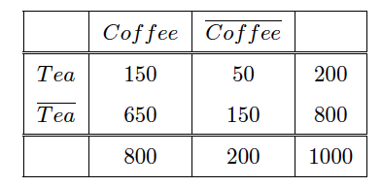
Interesting Association Rules
Not all high-confidence rules are interesting
{Tea} ➔ {Coffee} has support 0.15 and confidence 0.75
But 80% of people drink coffee anyway
Drinking tea decreases the probability to drink coffee!
Notes:
High confidence and support to not necessarily imply that a rule is interesting or useful. We illustrate this by the following example. The matrix indicates the number of items that like / do not like coffee or tea. If we consider the rule {Tea} –> {coffee} we will find that it has support 0.15 and confidence 0.75, which we may consider as very high. So at the first glance this looks like a good rule. Looking more carefully we will realize that actually 80% of the people drink coffee. In view of this, the rule just holds, because people in general drink a lot of coffee. Even worse, considering that 80% of people drink coffee, among the people drinking tea the propensity to drink coffee is less pronounced, only 75%. So drinking tea has a negative impact on drinking coffee which is the opposite of what the rule suggests. This motivates the need for other measures to evaluate whether a rule is interesting.

Slide 30
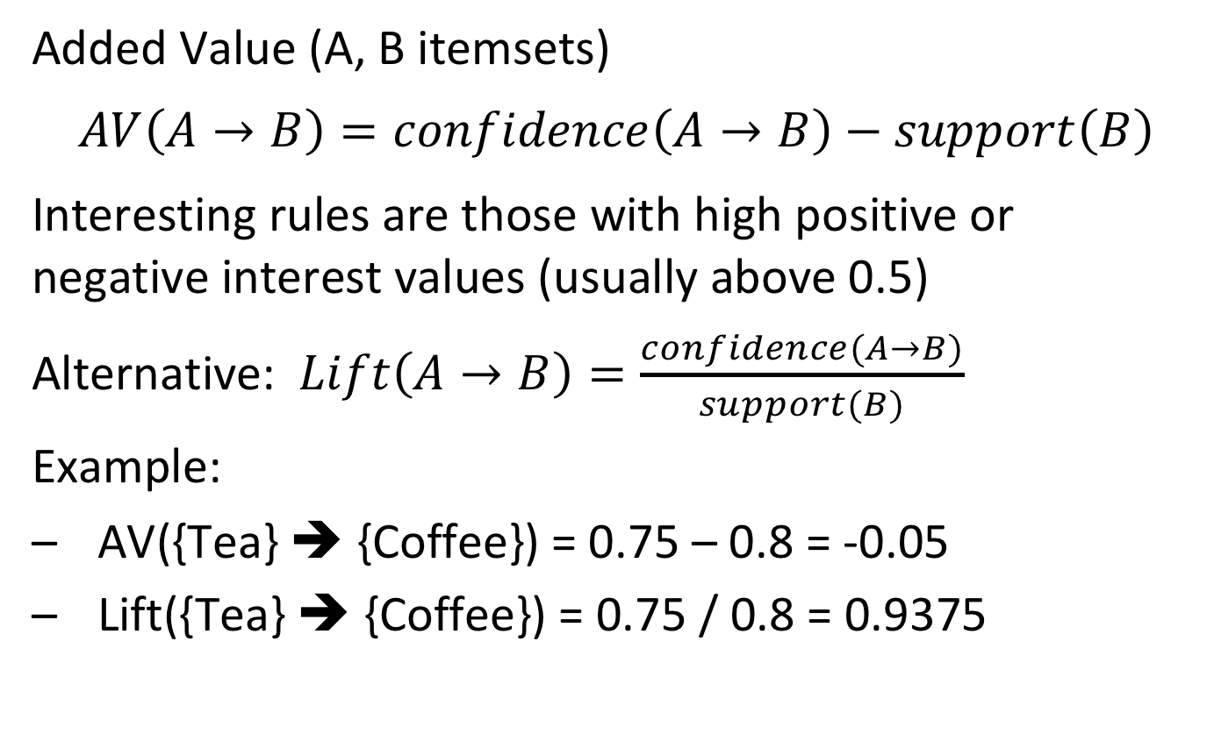
Alternative Measures of Interest
Added Value (A, B itemsets)
$$AV\left(A→B\right)=confidence\left(A→B\right)−support\left(B\right)$$
Interesting rules are those with high positive or negative interest values (usually above 0.5)
Alternative: $Lift\left(A→B\right)=\frac{confidence(A→B)}{support(B)}$
Example:
AV({Tea} ➔ {Coffee}) = 0.75 – 0.8 = -0.05
Lift({Tea} ➔ {Coffee}) = 0.75 / 0.8 = 0.9375
Notes:
In order to account for the effect of rule heads with high support, its value can be considered as a correction of the confidence measure. There exist two variants of that approach, either taking the difference or the ratio.
A positive value of added value indicates that X and Y are related, a negative indicates that A prevents B from occurring. Only if the probability of finding item B when item A has been found is greater than the probability of finding item B at all can we say that A implies B.
Lift is closely related to Added Value: note that lift (A-> B) = P(A,B) / P(A) P(B). That implies that if A and B are independent lift equals 1 (and in that case added value equals 0). Added value converges to 1 when lift converges to infinity and added value converges to -1 when lift converges to 0.

Slide 31
Quantitative Attributes
Transforming quantitative (numeric ordered values) into categorical ones
Static discretisation into predefined bins
Dynamic discretisation based on the distribution of the data
The rules depend on the chosen discretisation!!
(1) age{x, [18,19]} ⋀ live{x, Lausanne} ➔ work{x, student}
(2) age{x, [20,21]} ⋀ live{x, Lausanne} ➔ work{x, student}
vs.
(1) age{x, [18,21]} ⋀ live{x, Lausanne} ➔ work{x, student}
Notes:
For quantitative attributes the search for association rule is more complex. A simple approach is to statically or dynamically discretize quantitative attributes into categorical attributes.
However, the rules that can be found depend on the discretization chosen. It may happen that the bins are for example too fine-grained, and a rule that could be expressed in a compact form at a coarser granularity is split into multiple rules.
For example: if age is discretized into steps of 2 years we would probably find rules
Age(X, 18..19) and lives(X, Lausanne) -> profession(X, student)
Age(X, 20..21) and lives(X, Lausanne) -> profession(X, student)
This could be also expressed as a rule
Age(X, 18..21) and lives(X, Lausanne) -> profession(X, student)
which is more compact but requires a different discretization.

Slide 32
Improving Apriori for Large Datasets
Transaction reduction
A transaction that does not contain any frequent k-itemset is useless in subsequent scans
Sampling
Mining on a sampled subset of DB, with a lower support
Partitioning (SON algorithm)
Any itemset that is potentially frequent in a DB must be frequent in at least one of the partitions of the DB
Notes:
Though the basic Apriori algorithm is designed to work efficiently for large datasets, there exist a number of possible improvements:
Transactions in the database that turn out to contain no frequent k-itemsets can be omitted in subsequent database scans.
The sampling method selects samples from the database and searches for frequent itemsets in the sampled database using a correspondingly lower threshold for the support.
One can try to identify first frequent itemsets in partitions of the database, that fits in memory. This method is based on the assumption that if an itemset is not frequent in one of the partitions at least (local frequent itemset) then it will also not be frequent in the whole database.

Slide 33
Sampling
Approach
Randomly sample transactions with probability p
Detect frequent itemsets with support p*s
Eliminate false positives by counting frequent itemsets on complete data after discovery
Refinements
If we assume that the m transactions are randomly sorted, we can just choose the first p*m ones
False negatives can be reduced by choosing a lower threshold, e.g. 0.9 p*s
Notes:
Random sampling has to consider two issues: false positives and false negatives. False positives can be dealt with by verifying the candidate itemsets on the complete transaction set. For false negative no such possibility exists. By decreasing the support threshold, the number of false negatives can be reduced, at the cost of testing more candidate itemsets when scanning the complete dataset.
A further optimization can be achieved, when we know that the transactions occur in random order. Then sampling can be replaced by simple using the first p*m elements of the database.

Slide 34
Partitioning
Approach
Divide transactions in 1/p partitions and repeatedly read partitions into main memory
Detect in-memory algorithm to find all frequent itemsets with support threshold p*s
An itemset becomes a candidate if it is found to be frequent in at least one partition
On a second pass, count all the candidate itemsets and determine which are frequent in the entire set of transactions
Notes:
With partitioning we are not sampling the dataset, but processing the complete transaction set piece by piece. If an itemset is frequent in one partition (with a correspondingly adapted threshold), then it becomes a candidate. At this stage it is not sure that it is also frequent for the whole transaction set. Therefore in a second pass itemsets that are frequent are determined.

Slide 35
Partitioning – Why it works
Key “monotonicity” idea
an itemset cannot be frequent in the entire set of transactions unless it is frequent in at least one subset
Proof: If for all partitions support is below p*s, the total support is less than (1/p) p*s = s!
Notes:
The second pass is needed, since the condition of being frequent in at least one partition is necessary, but not sufficient.

Slide 36
Partitioning – Distributed Version
Partitioning lends itself to distributed data mining
Transactions distributed among many nodes
Compute frequent itemsets at each node
Distribute candidates to all nodes
Accumulate the counts of all candidates
MapReduce implementation!
Notes:
Partitioning is an embarrassingly parallel algorithm, and can therefore be naturally executed in a distributed environment, e.g. using Map-Reduce

Slide 37
A false negative in sampling can only occur for itemsets with support smaller than …
the threshold s
p*s
p*m
None of the above

Slide 38
FP Growth
Frequent itemset discovery without candidate itemset generation
Proceeds in 2 steps:
Build a data structure, called the FP-tree
Requires 2 passes over the dataset
Extract frequent itemsets directly from the FP-tree
Notes:
Though Apriori is as the original method the most popular rule mining algorithm, and also frequently used, other algorithms have been devised that attempt to provide better performance (under certain circumstances). FP Growth is one example of such an algorithm that is mainly aiming at main memory implementations (and thus less suitable for distributed implementation).

Slide 39
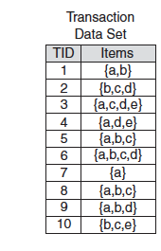
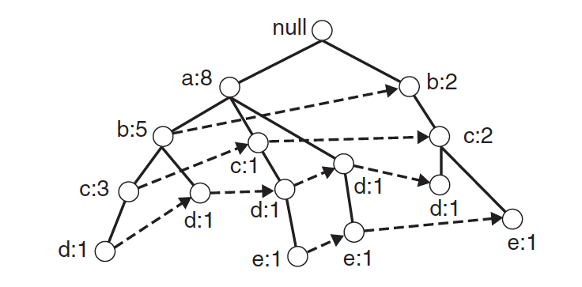
FP-Tree Data Structure
Itemset {b,c} occurs 5 times:
3 times with a
2 times without a
Itemset {a,b} occurs 5 times
Itemset {a,d} occurs 4 times
Items are sorted by decreasing support
Nodes correspond to single items
Counters indicate frequency of itemset from root to node
Different nodes for the same item are connected by a linked list
Notes:
FP Growth is based on the construction of a data structure, called FP-Tree. The core structure of and FP-Tree as similar to a trie. In order to construct the FP-Tree, first items in the itemsets are sorted. The nodes in the tree correspond to items, and paths from the root correspond to itemsets. Itemsets sharing the same prefix, share also the same path prefix in the tree. Counters at the nodes indicate how frequent the itemset corresponding to the path from the root to the node is. If we consider the left most path, we see that item a occurs 8 times, itemset ab 5 times, abc 3 times, and abcd once. Since the same item can occur in the tree in multiple places, these different occurrences are connected as linked list. For itemsets that occur in different paths (e.g. bc, which occurs together with a and without a), the frequencies can be computed by following the linked lists of the last item in the itemset and testing whether the other items are present in the path.

Slide 40
FP-Tree: Item Sorting
Item frequencies
a: 8
b: 7
c: 6
d: 5
e: 3
FP-Tree Size: The FP-Tree is more compact the more common prefixes the itemsets share
Sorting items by decreasing support increases this probability
Notes:
Sorting items in itemsets by decreasing support is an important heuristics to keep the FP-Tree compact, as more frequent items tend to be on the top of the tree which increases the likelihood that different itemsets share a common prefix. In the example we had sorted the items this way. If it is not the case they are resorted according to their frequencies.

Slide 41
Step 1: FP-Tree Construction
Requires 2 passes over the dataset
Pass 1: Compute support for each item
Pass over the transaction set
Sort items in order of decreasing support
Pass 2: Construct the FP-Tree data structure
Tree is expanded one itemset at a time
Notes:
To construct the FP-Tree one proceeds in two passes (not to confuse with the two steps of the overall FP-Growth algorithm mentioned in the beginning). In a first pass the transactions are scanned to compute the support for each single item. The items are then sorted in decreasing order. This order is being used to sort itemsets as required by the specification of the FP-Tree.
In the second pass the FP-Tree structure itself is constructed by adding one itemset at a time.

Slide 42
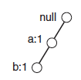
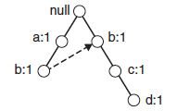
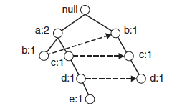
Step 1: FP-Tree Construction
Adding itemset 1
Adding itemset 2
Adding itemset 3
Notes:
Constructing the FP-Tree proceeds in a way analogous to constructing a trie structure. The items in the itemset are processed in their order. If for the current item there exists already a node, no new node is created. If it does not exist, a new branch is created for the items. The number of occurrences is updates by 1 at each node that is traversed (since each subset of the itemset is also an itemset). Finally links are introduced between nodes with the same labels.

Slide 43
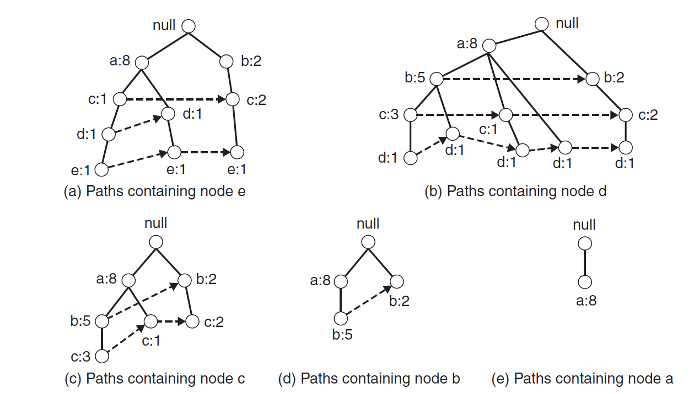
Step 2: Frequent Itemset Extraction
Bottom-up approach
For each item extract the tree with paths ending in the item
x
x
x
x
x
Removing all nodes not on a path to node e
Notes:
In the second step frequent itemsets are extracted. For each item first a subtree is extracted from the full FP-Tree that contains only the paths with the item. For extracting those subtrees the linked lists are helpful. One needs to traverse just the corresponding list and retain the paths from the traversed nodes to the root.
The figures illustrates the five resulting subtrees.

Slide 44
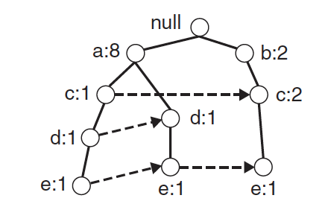
Step 2: Divide and Conquer Strategy
Start with item with lowest support (e.g. item e) and extract it’s tree
Check whether the item has sufficient support (e.g. 2)
Add up counts along the list of the item
E.g. item e has support 3
Notes:
Then start processing for the item with the lowest support. First we verify that the item has sufficient support. This we can simply do by following the list and adding up all the counts found. In the example, item e would this have support 3. If the support is above threshold processing proceeds, otherwise we know that no itemset containing e has sufficient support.

Slide 45
Step 2: Divide and Conquer Strategy
If item has sufficient support, check for itemsets ending in the item
Example: if item e is frequent check whether itemsets de, ce, be, ae are frequent
Again in order of lowest support
In order to check whether these itemsets are frequent compute a conditional FP-Tree
Notes:
If we find that the item at hand (e.g. item e) has sufficient support, then we check next whether the itemsets consisting of two items and ending in the item have also sufficient support. For doing so we derive now a conditional FP-Tree from the tree that we have constructed before for the item. The conditional tree is constructed in three steps:
First the support counts in the tree are updated such that only the number of itemsets containing the current item is considered. This can be simply performed traversing the paths from the bottom to the root.
Then the nodes corresponding to the current item are removed
Finally all nodes that have an insufficient support count are also removed from the conditional FP Tree

Slide 46
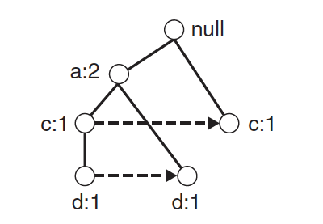
Conditional FP-Tree
The FP-Tree that would be built if we only consider transactions containing a particular itemset and omitting this itemset (e.g. {e})
Removing that itemset from the tree and dropping items that are not frequent
Considering transactions containing e
Omitting e
Dropping non-frequent items (b)
Notes:
One way to understand the construction of the conditional FP Tree is that it is the FP Tree that would be constructed when we only consider the transactions that consider the curent item (or itemset) and then remove e and any non-frequent item from those itemsets. In the example this would be item e that we consider, and item b would be eliminated, since not frequent in the remaining transactions.

Slide 47
Deriving Conditional FP-Tree
The conditional FP-Tree can be derived from extracted tree
Update support counts to itemsets containing the item
Remove the nodes of the item
Remove nodes with insufficient support count
2
1
2
x
1
1
1
1
1
1
1
2,3
0
2,3
1
1
x
x
x

Slide 48
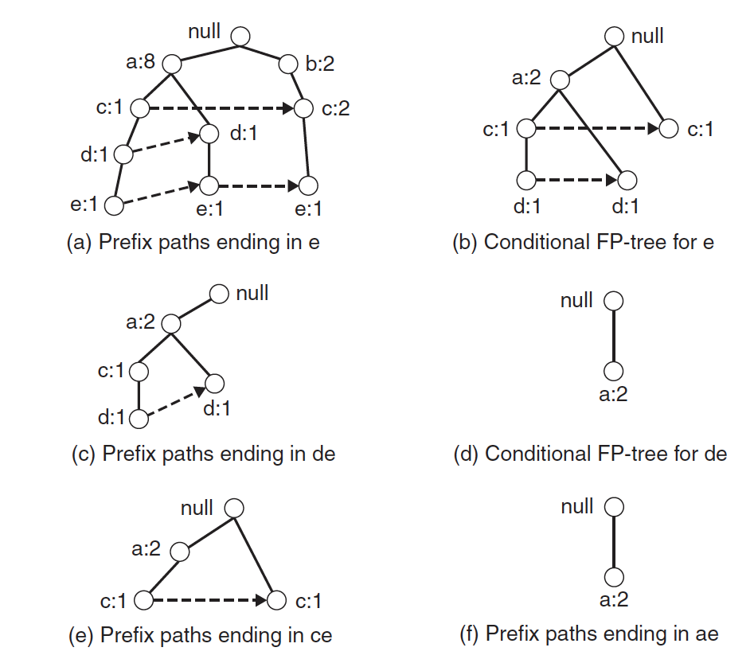
Conditional FP-Tree
2 paths ending in e
(sufficient support)
Item b has only
support count 1
(thus removed)
de has support count 2
ade has support count 2
ae has support count 2
ce has support count 2
Notes:
Here we show all conditional FP Trees that would be constructed from 2-itemsets ending in item e. Once the conditional FP Trees have been constructed, we can read off the support for all 2-itemsets, by traversing the lists at the leaf level (as we did first for item e itself). Once this step is finished, the algorithm continues in the same way for the remaining 2-itemsets. For example, for itemset de we would now construct a conditional FP Tree, by first extracting from tree (b) the tree with paths ending in de, resulting in tree (c), and then extracting the conditional FP Tree for itemset de (tree (d)).

Slide 49
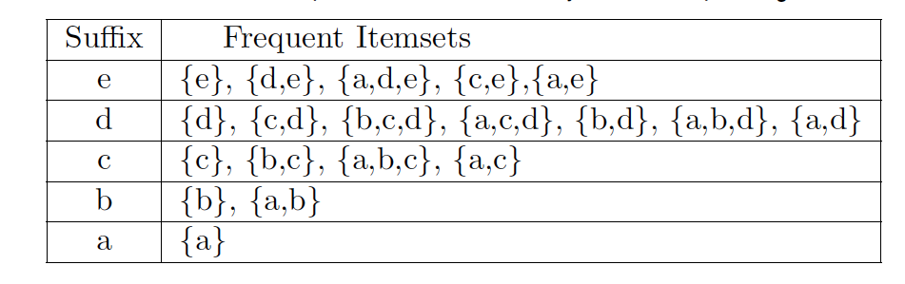
Result
Frequent itemsets detected in this order
Notes:
This table summarizes the frequent itemsets in the order they are detected, i.e., starting from the items with the lowest support.

Slide 50
In the first pass over the database of the FP Growth algorithm
Frequent itemsets are extracted
A tree structure is constructed
The frequency of items is computed
Prefixes among itemsets are determined

Slide 51
The FP tree below is …
not valid, b is missing
not valid, since count at leaf level larger than 1
possible, with 2 transactions {a}
possible, with 2 transactions {a,c}
null
a:3
c:2

Slide 52
Summary FP Growth
Advantages
Only 2 passes over the dataset
Compresses dataset
(Generally) much faster than Apriori
Disadvantages
Works less efficiently for high support thresholds
Has to run in main memory
Difficult to find distributed implementation
Notes:
FP Growth Works less efficiently for high support thresholds, because it prunes only single items.

Slide 53
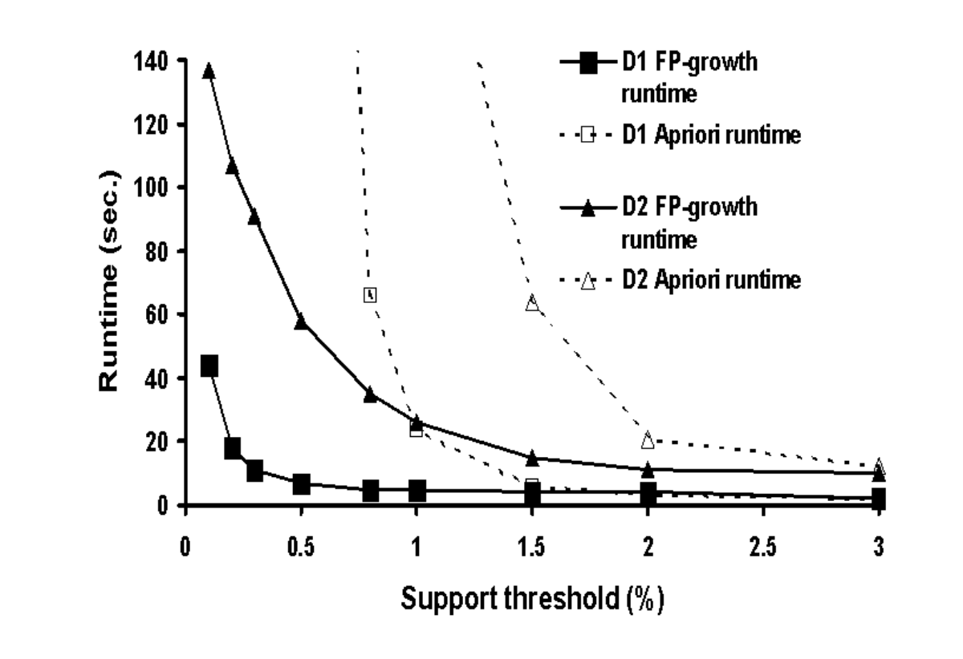
Performance Comparison

Slide 54
Components of Data Mining Algorithms
Pattern structure/model representation
association rules
Scoring function
support, confidence
Optimisation and search
JOIN, PRUNE
FP-Tree, ordering of items
Data management
transaction reduction, partitioning, sampling

Slide 55
References
Textbook
http://www.mmds.org/mmds/v2.1/ch06-assocrules.pdf
Jiawei Han, Data Mining: concepts and techniques, Morgan Kaufman, 2000, ISBN 1-55860-489-8
Pang-Ning Tan, Michael Steinbach, Vipin Kumar: Introduction to Data Mining, Addison-Wesley. Chapter 6: Association Analysis: Basic Concepts and Algorithms
Some relevant research literature
R. Agrawal, T. Imielinski, and A. Swami. Mining association rules between sets of items in large databases. SIGMOD'93, 207-216, Washington, D.C.
J. Han, J. Pei and Y. Yin. Mining Frequent patterns without candidate generation. SIGMOD 2000, 1–12.

